Slide 1
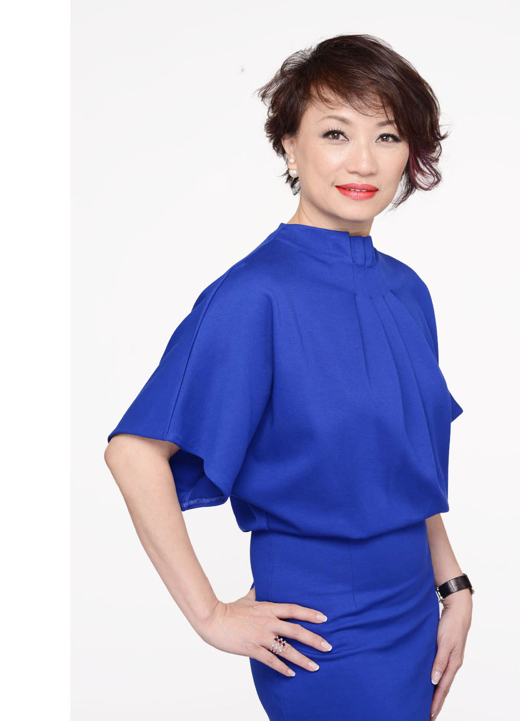
Michelle Lieu
NATIONAL SUPERVISING COORDINATOR
S$12,500 – S$18,749 IN 4WK PAY CYCLE
…..............................
MASG Certified Trainer
MASG Certified Motives® Trainer
ISM Certified Trainer
Master UFO
SABP Master Member
Field Product Specialist
Speakers’ Bureau II
Singapore Leadership Council Member
A W A R D S
Top 10 Retailer Award 2015
Top 10 UFO Retention Award 2015

Slide 2
my journey
APRIL 2017 • MICHELLE LIEU

Slide 3
Australia Mar 2014
• APR 2014 EXECUTIVE COORDINATOR
• JUN 2014 MASTER COORDINATOR
• NOV 2014 SNR MASTER COORDINATOR
• OCT 2015 PROFESSIONAL COORDINATOR
• OCT 2016 SUPERVISING COORDINATOR
• JAN 2017 NATIONAL SUPERVISING COORDINATOR
MASG Annual Convention Apr 2015
Greensboro Aug 2015
Apac Regional Convention Oct 2015
MASG Annual Convention Apr 2016
Greensboro Aug 2016
MASG Leadership School Oct 2016
Miami Feb 2017

Slide 4
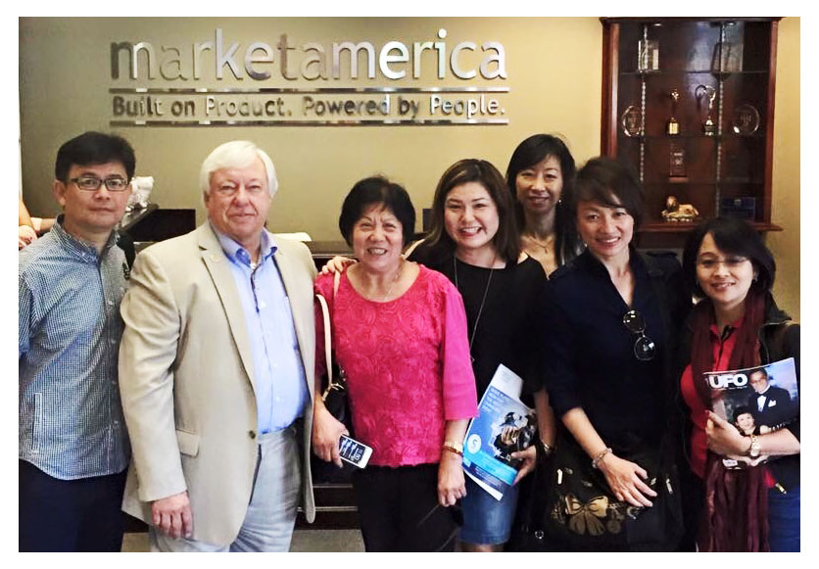
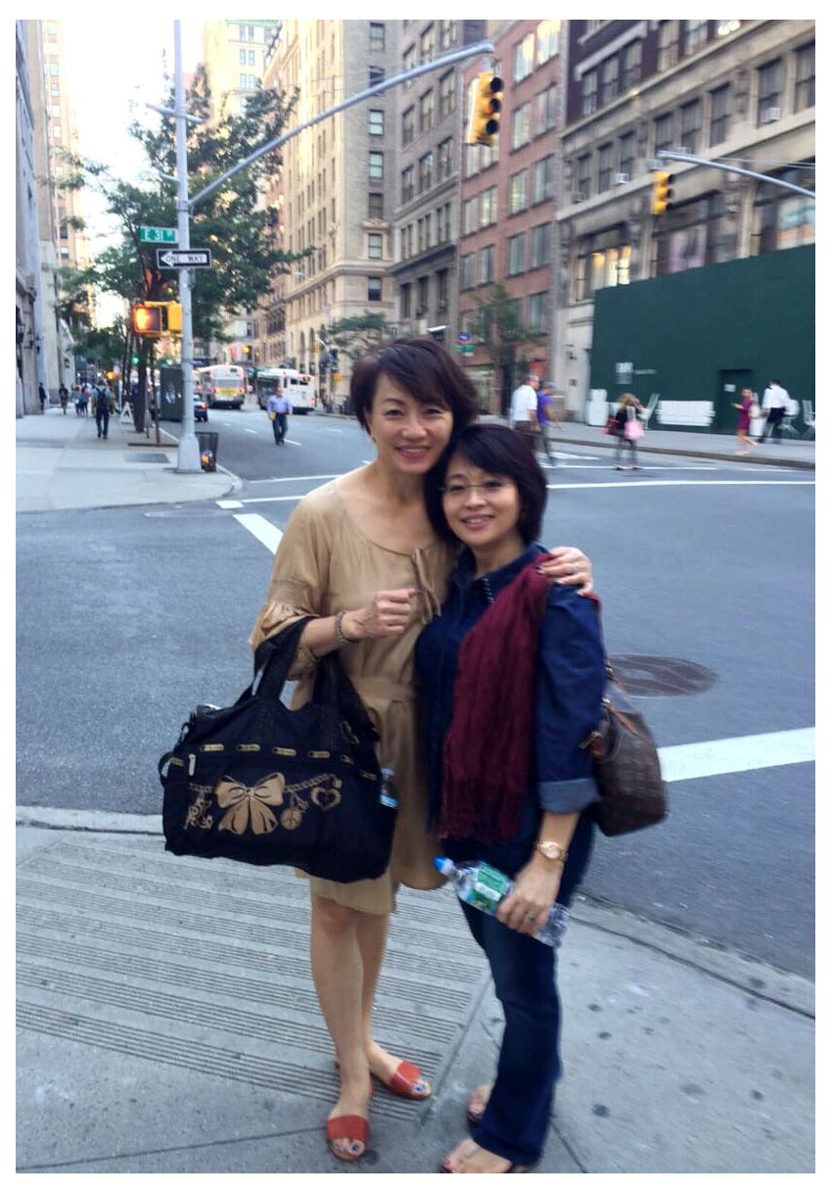
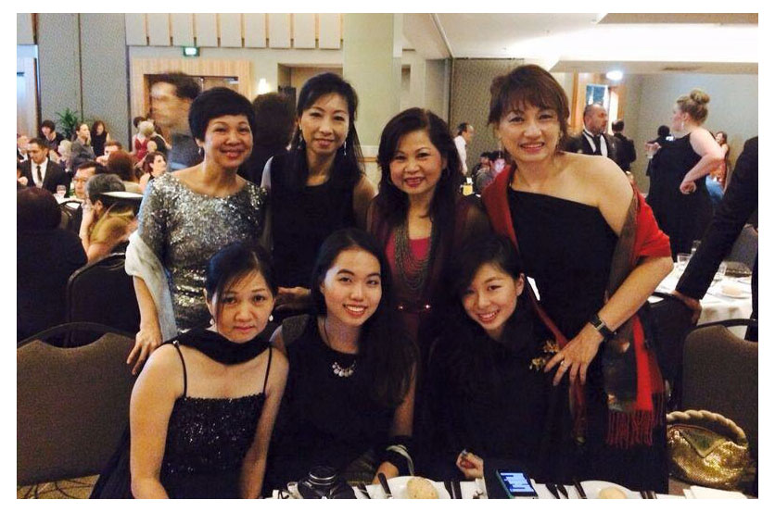
AUSTRALIA & GREENSBORO 2014

Slide 5
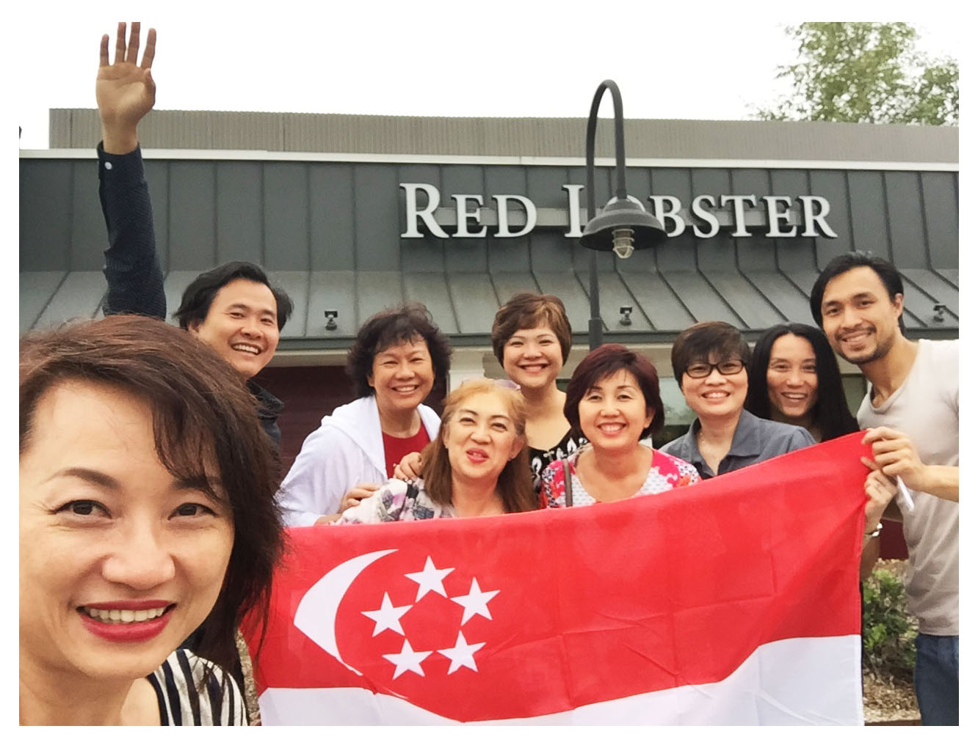
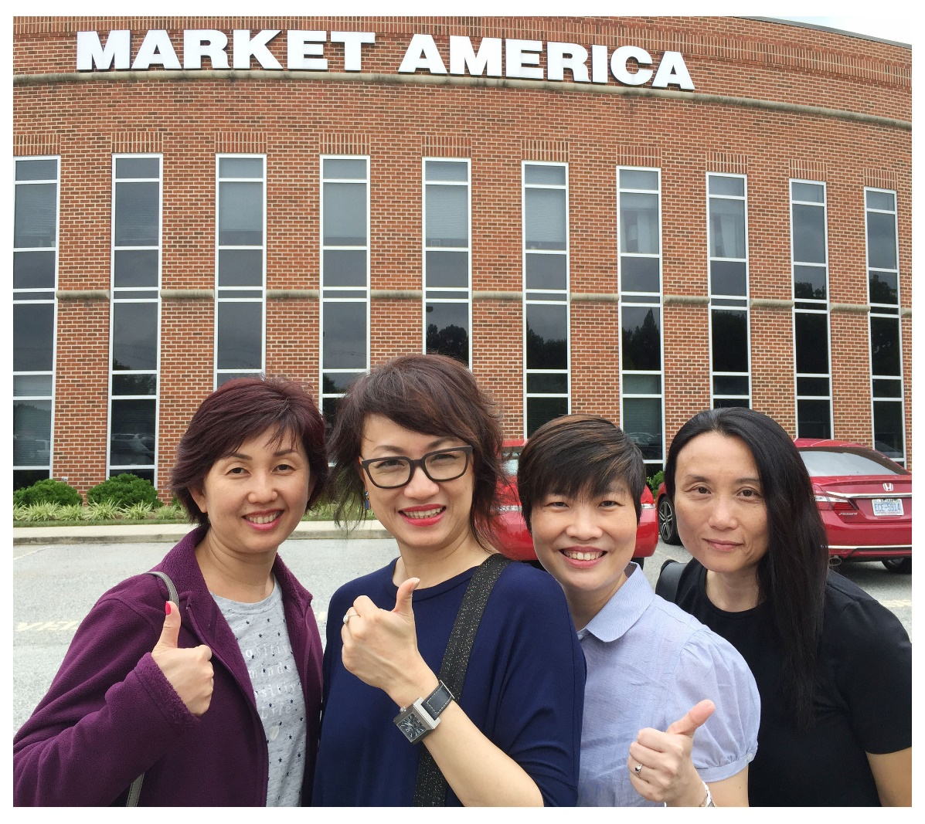
GREENSBORO 2016

Slide 6
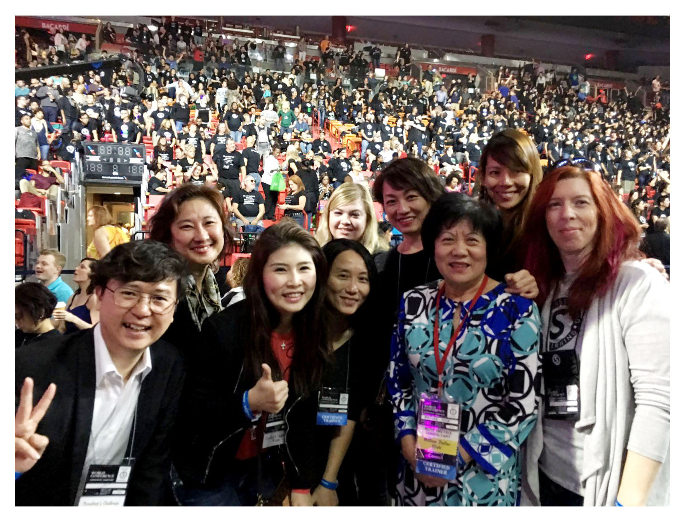
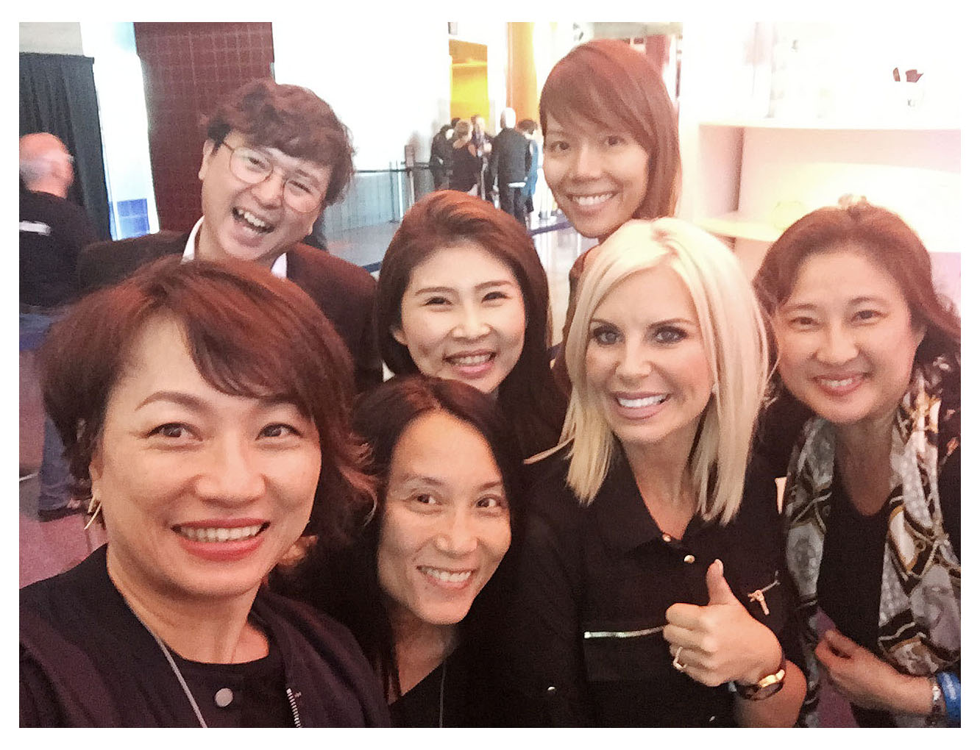
MIAMI 2016

Slide 7
1 + 1
1 + 3
1 + 5
Greensboro Aug 2015
Greensboro Aug 2016
Miami Feb 2017
1+30
Greensboro Aug 2017

Slide 8
MARKET AMERICA
10 – 13 AUG • GREENSBORO
2017
INTERNATIONAL
CONVENTION

Slide 9
success leaves clues…
go find it!

Slide 10
GMTSS
LEVERAGE!

Slide 11
Your life don’t change by chance
Your life will change
by change!

Slide 12
my why…
…guided my every action

Slide 13
my belief…
… helped me stayed on course

Slide 14
“ …we have to succeed…
so that others can
realize their dreams ”
_{JR.}

